Slide 1
Protein purification lecture
Alessandro Minafra
Thomä Lab – EPFL

Slide 2
What is Protein Purification?
Protein purification is a process in molecular biology and biochemistry to isolate a specific protein from a complex mixture – called protein of interest. It’s critical in:
Biological Research: Developing enzymes and antibodies to study cellular processes
Diagnostics: Creating assays and tests for diseases
Environmental Monitoring: Detecting contaminants using biosensors
Food & Cosmetics: Ensuring safety and quality standards
Forensic Science: Identifying substances in investigations
Biopharmaceuticals: Producing therapeutic proteins and vaccines
Notes:
Protein purification is a cornerstone of molecular biology and biochemistry. It’s about isolating a target protein from a mix—usually from cells or tissues.
This process is vital across many areas. In biological research, purified proteins help us create tools like enzymes and antibodies that unravel cellular mysteries. Diagnostics relies on these proteins for disease detection. Environmental monitoring uses protein biosensors to find contaminants.
In food and cosmetics, purification ensures safety and compliance, minimizing risks like allergic reactions. Even forensic science employs proteins for crime-solving. Lastly, in biopharma, it’s essential for making therapeutic proteins and vaccines.
In summary, protein purification is foundational to both scientific discovery and practical applications.”

Slide 3
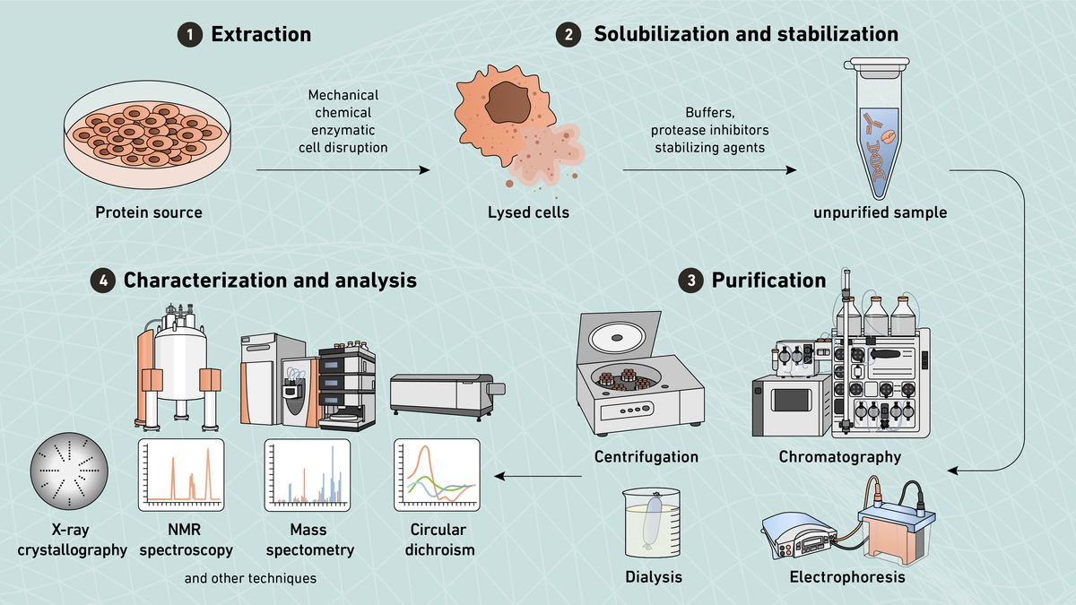
Typical Protein Purification Workflow
Steps Involved:
Sourcing
Extraction
Stabilization
Purification
Characterization
Zamora C., 2024, Technology Networks
Notes:
A typical protein purification workflow consists of five key steps. First, we source the protein, either from natural tissues or through recombinant expression. Next, extraction is performed to release the protein from cells. Solubilization and stabilization steps maintain the protein’s solubility and activity. Purification isolates the target protein, and finally, characterization ensures its identity and functionality.
Sourcing: Native tissues or recombinant expression
Extraction: Cell lysis using mechanical, chemical, or enzymatic methods
Stabilization: Buffers, protease inhibitors, detergents for solubility
Purification: Centrifugation, precipitation, chromatography
Characterization: SDS-PAGE, spectroscopy, activity assays,
advanced structural techniques

Slide 4
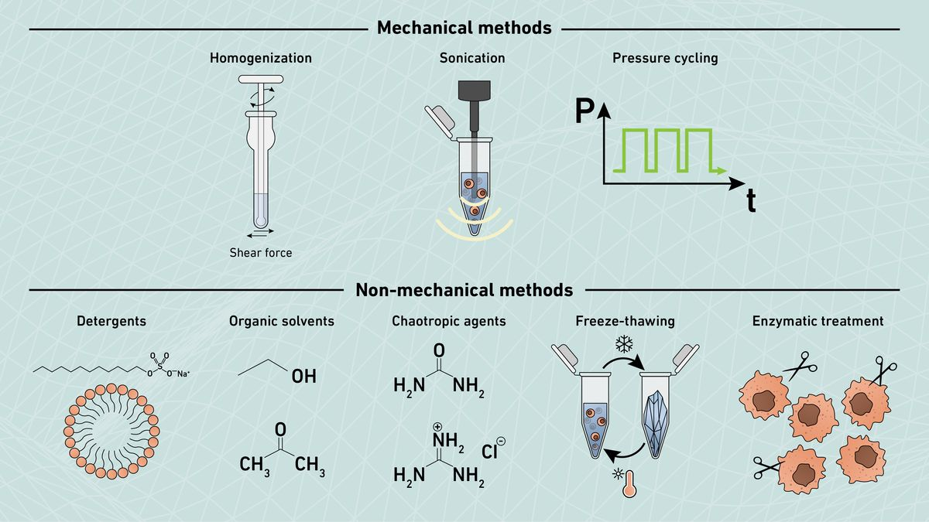
Protein Extraction Methods
Zamora C., 2024, Technology Networks
Notes:
Sonication as you did yesterday is the most common tech used. It use sounds waves to disrupt the protein membrane
This slide highlights the main methods for protein extraction. Mechanical methods, like homogenization and sonication, are ideal for tough tissues and bacterial cells, though heat generation can be a concern.
Non-mechanical options, such as detergents and organic solvents, are effective but require careful handling to avoid denaturation. Freeze-thawing is a simple technique but can be inefficient, while enzymatic treatments, like lysozymes, are gentle and specific but limited in scope. Selecting the right method depends on your target protein and the cells you’re working with.
A. Mechanical Methods
1. Homogenization
Pros: Effective for tough tissues
Cons: Can generate heat, which may damage proteins
2. Sonication
Pros: Quick and efficient for small volumes
Cons: Requires cooling to avoid overheating
3. Pressure Cycling
Pros: Gentle on proteins; preserves their native structure
Cons: Requires specialized and expensive equipment
4. Cryogenic Grinding
Pros: Ideal for disrupting tough cell walls (e.g., yeast); prevents heat damage
Cons: Requires liquid nitrogen and can be labor-intensive
B. Non-Mechanical Methods
1. Detergents
Pros: Effective for solubilizing membrane proteins
Cons: Risk of denaturing sensitive proteins
2. Organic Solvents hexanes, toluene, dichloromethane and diethyl ether (hydrophobic contact )
Pros: Quick and efficient
Cons: Can denature proteins and affect downstream applications
3. Chaotropic Agents (urea , guanidine hcl, they interfere with hydrophobic contact )
Pros: Useful for extracting insoluble proteins
Cons: Proteins may require refolding after extraction
4. Freeze-Thawing
Pros: Simple and requires minimal equipment
Cons: Time-consuming and often inefficient for some cells
5. Enzymatic Treatment
Pros: Specific, gentle, and preserves protein structure (pectinase)
Cons: Limited to bacterial cells and can be expensive

Slide 5
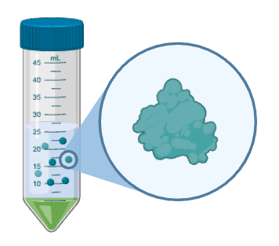
Protein Purification Techniques Overview
Techniques:
Centrifugation
Precipitation
Chromatography
Ultrafiltration and Dialysis
Electrophoresis
BioRender
Notes:
Protein purification uses various techniques to isolate proteins based on properties like size, charge, and affinity. These include centrifugation, precipitation, chromatography, ultrafiltration, and electrophoresis. Each method plays a specific role in achieving high purity and functionality.
Centrifugation is one of the first steps in purification, separating components based on density. Heavier particles form a pellet, leaving the lighter protein-containing supernatant for further processing (all the debris)
Precipitation is a cost-effective way to concentrate proteins. Salting out with ammonium sulfate or changing pH helps aggregate proteins, but optimization is needed to avoid co-precipitating contaminants.
Protein the pellet

Slide 6
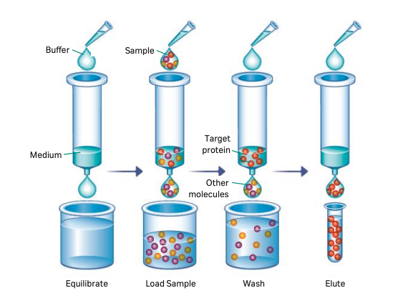
What is chromatography?
Separation of components using differential affinities of the components for a mobile phase and for a stationary phase, through which they pass
Cytiva Life Sciences, Protein Purification Handbook
Notes:
A protein purification method typically includes one or more chromatographic steps. The basic procedure involves passing a solution containing the protein through a column packed with specific materials. Proteins are separated based on the time required to pass through the column or the conditions needed to elute them. Proteins are usually detected as they elute from the column by their absorbance at 280 nm.
Chromatography is the most versatile purification method.
- Gas Chromatography (GC): Uses a gaseous mobile phase for separating volatile compounds, ideal for small organic molecules and gases.
- Thin-Layer Chromatography (TLC): Employs a solid stationary phase and a liquid mobile phase, suitable for analyzing mixtures like pigments or small organic molecules.
Liquid chromatography
Buffer (mobile phase) pass through a medium (resin) containing chromatography beads (stationary phase)
Different bead properties can be used to purify different target proteins – For example, a bead with small pores can be used to purify a small target from larger molecules in the same sample

Slide 7
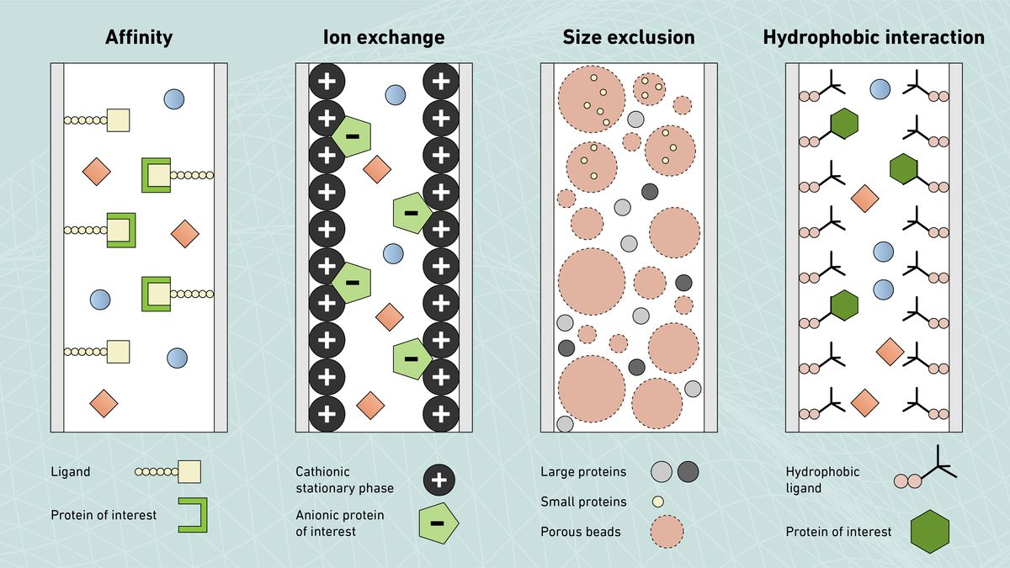
Protein properties used in chromatography
Zamora C., 2024, Technology Networks
Notes:
Chromatography is the most versatile purification method.
Affinity chromatography targets specific proteins, while ion exchange uses charge differences. SEC is ideal for size-based separation, and HIC handles hydrophobic proteins.
Affinity chromatography is a powerful technique that isolates proteins based on specific interactions with ligands on a resin. After the target protein binds, contaminants are washed away, and the protein is eluted under controlled conditions. It’s highly specific, especially for tagged proteins like His-tags or natural binding partners like antibodies, making it an essential step for high-purity purification.
Principle: Utilizes specific interactions between a protein and a ligand bound to the stationary phase
How It Works:
Protein binds to the ligand on the resin
Unbound contaminants are washed away
Protein is eluted under specific conditions (e.g., pH or salt change)
Applications:
Purification of tagged proteins (e.g., His-tag, GST-tag, MBP-tag)
Isolating proteins with natural binding partners (e.g., antibodies, receptors)
Advantages:
High specificity and purity
Requires minimal optimization for tagged proteins

Slide 8
Affinity Chromatography (AC) : Protein tagging
Protein tagging involves adding a specific amino acid sequence to the protein of interest to facilitate purification
Tag | Description | Binding partner | Size | Applications
His | Polyhistidine sequence | Nickel/cobalt ions | Small | General purification, protein interactions
GST | Glutathione S-transferase | Glutathione | Large | Solubility enhancement, activity assays
MBP | Maltose-binding protein | Amylose | Large | Solubility enhancement, protein folding
FLAG | Short peptide (DYKDDDDK) | Anti-FLAG antibody | Small | Western blotting, immunoprecipitation
Notes:
Affinity chromatography is a powerful technique that isolates proteins based on specific interactions with ligands on a resin. After the target protein binds, contaminants are washed away, and the protein is eluted under controlled conditions. It’s highly specific, especially for tagged proteins like His-tags or natural binding partners like antibodies, making it an essential step for high-purity purification.
GST, MBP,SUMO for solubility.
Elution of Streptavidin: Biotin and Strepactin
Elution of mbp (maltose)
Elution of FLAG (flag peptide)
Elution on his tag: imidazole

Slide 9
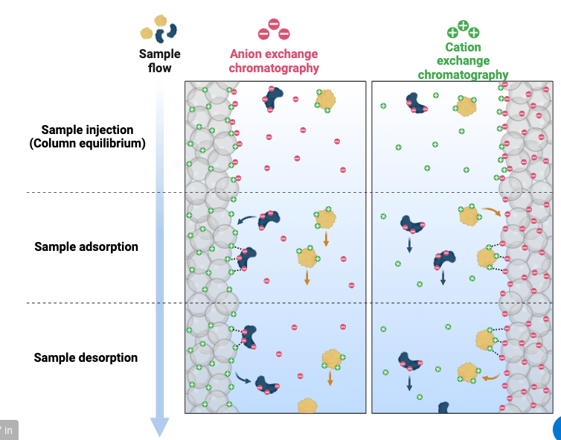
Ion Exchange Chromatography (IEX)
Principle: Separates proteins based on their charge
Anion Exchange: Binds negatively charged proteins using positively charged resins
Cation Exchange: Binds positively charged proteins using negatively charged resins
An
BioRender
Notes:
ION EXCHANGE CHROMATOGRAPHY
• It separates compounds according to the nature and degree of their ionic charge.
• The column to be used is selected according to its type and strength of charge. Anion exchange resins have a positive charge and are used to retain and separate negatively charged compounds, while cation exchange resins have a negative charge and are used to separate positively charged molecules.
• Before the separation begins, a buffer is pumped through the column to equilibrate the opposing charged ions.
• Upon injection of the sample, solute molecules will exchange with the buffer ions as each competes for the binding sites on the resin.
• The length of retention for each solute depends upon the strength of its charge.
• Most weakly charged compounds will elute first, followed by those with successively stronger charges.
• The nature of the separating mechanism, pH, buffer type, buffer concentration, and temperature all play important roles in controlling the separation.
• This chromatography is a very powerful tool for use in protein purification.
For Anion Exchange Columns (positively charged functional groups to bind anions):
• Quaternary amines (Q): Strong anion exchangers.
• Diethylaminoethyl (DEAE): Weak anion exchangers.
For Cation Exchange Columns (negatively charged functional groups to bind cations):
• Sulfopropyl (SP): Strong cation exchangers.
• Carboxymethyl (CM): Weak cation exchangers.

Slide 10
Choosing Ion Exchange Chromatography Based on Protein’s Isoelectric Point (pI)
Isoelectric Point (pI): The pH at which a protein has no net charge
Deciding the Type of Ion Exchange:
Determine the protein’s pI
Adjust the buffer pH of 2 points:
pH > Protein’s pI:
  Protein is negatively charged.
  Use anion exchange (e.g., Q Sepharose - HiTrap Q)
  pH < Protein’s pI:
    Protein is positively charged.
    Use cation exchange (e.g., SP Sepharose HiTrap S)
Example:
Most proteins pI ~6 → Use anion exchange at pH 8
TFs (DNA binding) pI 8.5 → Use cation exchange at pH 6.5
Notes:
Choosing the right ion exchange technique depends on the protein’s isoelectric point. At pH below the pI, the protein is positively charged, favoring cation exchange. Above the pI, the protein is negatively charged, favoring anion exchange. Adjust the buffer pH accordingly to optimize separation and binding

Slide 11
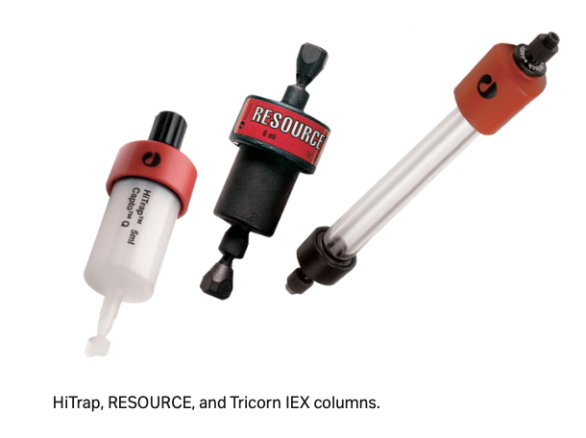
Common Resins Used in Ion Exchange Chromatography
Anion Exchange Resins
HiTrap Q
RES Q
Mono Q
Cation Exchange Resins
HiTrap S
RES S
Cytiva Life Sciences
Notes:
Introduction
• In this slide, we will discuss the most common resins used in ion exchange chromatography, their properties, and their applications.
• Ion exchange resins are classified based on their ability to retain negatively or positively charged molecules, and the choice of resin depends on the target molecule and purification goals.
Anion Exchange Resins
1. RES Q
• This is a strong anion exchange resin designed to retain negatively charged molecules like nucleic acids and certain proteins.
• It’s widely used due to its high capacity and compatibility with a variety of samples.
2. HiTrap Q
• Another strong anion exchange resin. It is well-suited for both small- and large-scale protein purification workflows.
• Its high binding capacity makes it effective for general purification tasks.
3. Mono Q
• Mono Q is a high-resolution anion exchange resin, often used when fine separation of negatively charged biomolecules is required.
• It’s particularly useful for analytical purposes or in cases where detailed separation is needed.
Cation Exchange Resins
1. HiTrap S
• HiTrap S is a strong cation exchange resin that binds positively charged molecules such as basic proteins and peptides.
• It is commonly used in preparative chromatography for protein purification.
2. RES S
• Similar to HiTrap S, but with a higher capacity for positively charged biomolecules.
• This resin is ideal for larger-scale purification or when working with high-concentration samples.

Slide 12
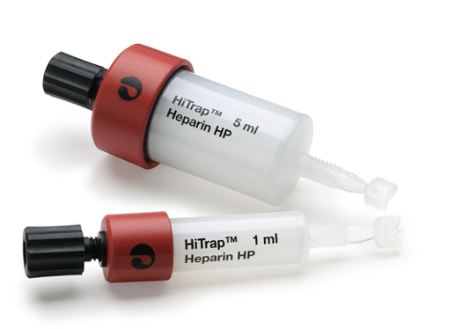
Common Resins Used in Ion Exchange Chromatography
Specialized Resin
Heparin Resin
Type: Affinity resin with additional ion exchange properties
Purpose: Binds proteins with heparin-binding domains (e.g., coagulation factors, growth factors)
Applications: Ideal for purifying DNA-binding proteins (TFs), enzymes, and growth factors
  Removes non-specific DNA, enabling precise TF-DNA interaction studies with the DNA of interest
Cytiva Life Sciences
Notes:
Specialized Resin
1. Heparin Resin
• Heparin resin is unique because it combines affinity and ion exchange properties.
• It binds specifically to proteins with heparin-binding domains, such as growth factors, coagulation factors, and DNA-binding proteins.
• This resin is a versatile choice for purifying biomolecules with specific binding affinities.
Conclusion
• The choice of resin plays a critical role in achieving successful purification.
• RES Q, HiTrap Q, and Mono Q are excellent for separating negatively charged molecules, while HiTrap S and RES S focus on positively charged targets.
• Heparin resin is specialized for more specific applications, making it a valuable tool in many research contexts.
Tip for the Audience: Always consider the charge of your target molecule and the resolution required for your application when selecting a resin.

Slide 13
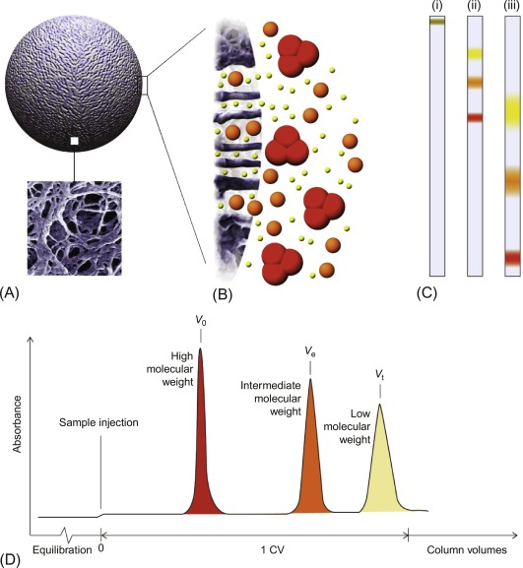
Size Exclusion Chromatography (SEC)
Overview
SEC separates molecules based on their size
The column is packed with porous beads that act as a molecular sieve
How it Works
Large Molecules:
Do not enter the pores
Bypass the beads and elute first
Small Molecules:
Enter the pores of the beads
Travel a longer path and elute later
Hall, M. (2018). Biopharmaceutical Processing
Notes:
What you will do tomorrow
• Introduction:
Let’s talk about size exclusion chromatography, or SEC, a technique widely used in protein purification and molecular analysis.
• SEC is unique because it separates molecules based on their size, not charge or other properties.
• How It Works:
• The column is packed with porous beads that act like tiny sieves.
• Large molecules, like aggregates, cannot enter the pores, so they take a shorter path and elute first.
• Smaller molecules, such as monomers, can enter the pores and take a longer path, eluting later.
Applications:
• SEC is primarily used to separate monomers from aggregates, Separation of monomers from multimers
ensuring that the final purified protein is in its correct form.
• It’s also a common final polishing step in protein purification pipelines.
• Additionally, SEC is used for analyzing molecular size distribution, which is critical in structural biology and protein formulation studies.
• Wrap-Up:
This makes SEC a powerful and essential technique in any protein purification workflow.

Slide 14
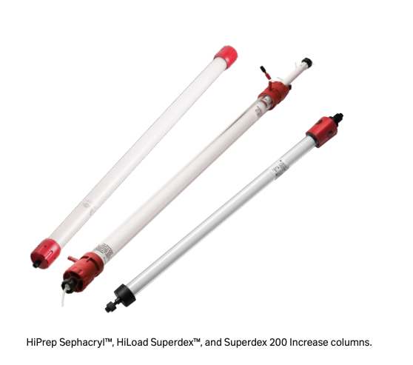
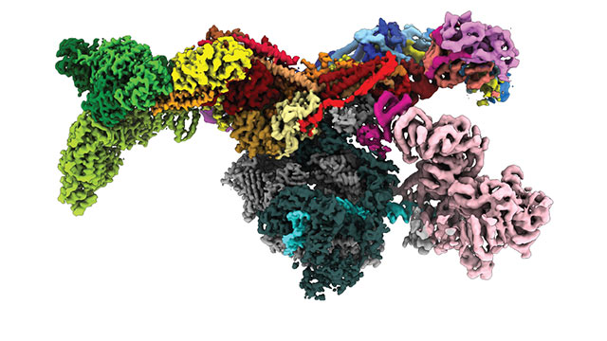
Columns Used in SEC
Superdex Columns
  High-resolution columns designed for separating proteins and other biomolecules
  Superdex columns come in different sizes to accommodate varying sample volumes
    Superdex Peptide small peptides and very small proteins (Mw<10kDa)
    Superdex 75 small-to-medium proteins (Mw 3-70 kDa)
    Superdex 200 medium-to-large proteins and complexes (Mw 10-600 kDa)
Cytiva Life Sciences
What do we use when we have big complexes?
Notes:
• Introduction:
Now let’s look at the types of columns commonly used in SEC and how to select the right one for your needs.
• Column Types:
• Superdex Columns:
These are high-resolution columns widely used for separating proteins and biomolecules. They’re suitable for both analytical and preparative work.
• Sephadex Columns:
These are made from cross-linked dextran, which is ideal for smaller molecules. They’re great when you’re working with peptides or small biomolecules.
• Bio-Gel P Columns:
These columns are designed for peptides and small proteins, offering reliable fractionation in that range.
• Selection Factors:
When choosing a column, consider the molecular weight range of your target molecule.
• For high-resolution applications, Superdex and TSKgel columns are great choices.
• For smaller molecules or peptides, Sephadex or Bio-Gel P columns are more suitable.
• Also, match the column size to your sample volume to maximize efficiency.
Conclusion:
Choosing the right column is essential for achieving the best separation and purification results. SEC is a versatile and critical tool for protein purification, and the column selection directly impacts its effectiveness.
Superdex Columns
High-resolution columns designed for separating proteins and other biomolecules.
Suitable for both analytical and preparative purposes.
Superdex Peptide small peptides and very small proteins (Mw<10kDa)
Superdex 75 small-to-medium proteins (Mw 3-70 kDa)
Superdex 200 medium-to-large proteins and complexes (Mw 10-600 kDa)
2. Sephadex Columns
Made from cross-linked dextran, ideal for fractionation of smaller molecules
3. Bio-Gel P Columns
Designed for the separation of peptides and smaller proteins

Slide 15
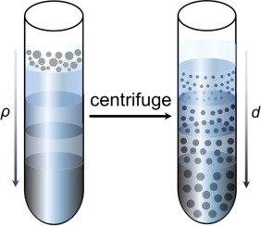
Techniques for Separating Large Proteins and Complexes: Density Gradient Ultracentrifugation
For very large proteins or complexes exceeding SEC capabilities, density gradient ultracentrifugation is an effective alternative:
Principle: High-speed centrifugation separates particles by size and density in a gradient (e.g., sucrose, glycerol)
Applications: Purifies large protein complexes, organelles, and fractionates proteins while assessing stability
Notes:
or very large proteins, protein complexes, or structures exceeding the capabilities of size exclusion chromatography, alternative techniques are required:
we resche the protein with a pipetes and then we remove the density gradient by using dyalisis
Density Gradient Ultracentrifugation
Uses high-speed centrifugation with density gradients to separate particles by mass and density
How It Works:
A protein solution is loaded onto a pre-formed gradient (e.g., sucrose, Glycerol)
Under centrifugal force, proteins migrate to their equilibrium density or sediment based on their size
Applications:
Purifying large protein complexes or organelles.
Fractionating proteins or analyzing complex stability.
made this shorter

Slide 16
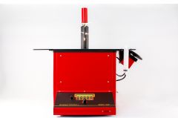
Techniques for Separating Large Proteins and Complexes: GraFix (Gradient Fixation)
GraFix (Gradient Fixation)
Combines gradient centrifugation and chemical fixation to separate and stabilize large protein complexes
How It Works:
Proteins are separated based on size and density in a density gradient (e.g., sucrose or glycerol)
During separation, chemical fixation/crosslinking (e.g., glutaraldehyde) is applied to preserve complex integrity
Applications:
Studying large macromolecular assemblies (e.g., CoFactors)
Preparing samples for cryo-EM or other structural studies
Notes:
It also creates a gradient of crosslinking
BS3 , reacw with the cysteine of the protein (thiolic group)

Slide 17
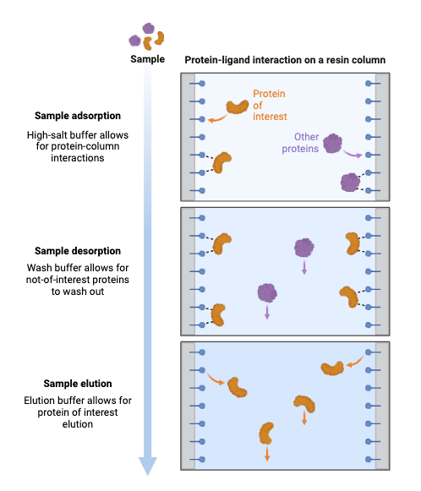
Hydrophobic Interaction Chromatography (HIC)
Principle: Separates proteins by hydrophobicity; hydrophobic domains bind to hydrophobic resin groups
How It Works
Binding: High salt promotes hydrophobic interactions with the resin
Elution: Lowering salt weakens these interactions, eluting proteins by hydrophobicity
Applications
Purifies proteins with hydrophobic domains
Removes aggregates and impurities
Acts as a complementary purification step
BioRender
Notes:
• Introduction:
Hydrophobic interaction chromatography, or HIC, is a powerful technique for separating proteins based on their hydrophobic properties.
• How It Works:
• In the presence of high salt concentrations, proteins with hydrophobic regions bind to the hydrophobic groups on the resin.
• This binding occurs because the salts reduce protein solubility, exposing hydrophobic regions that interact with the resin.
• During elution, the salt concentration is gradually lowered. Proteins elute based on their hydrophobicity—less hydrophobic proteins elute first, followed by more hydrophobic ones.
• Applications:
• HIC is particularly useful for purifying proteins with exposed hydrophobic domains.
• It’s effective at removing protein aggregates, which often have higher hydrophobicity compared to monomeric proteins.
• As a result, it serves as a polishing step in many purification workflows to ensure protein purity and homogeneity.
• Conclusion:
HIC is a valuable tool for specific purification challenges, especially when dealing with proteins prone to aggregation or containing significant hydrophobic domains. Its ability to fine-tune separation through salt gradients makes it versatile and precise.
Tip for the Audience: Always optimize salt concentration and resin selection based on your target protein’s hydrophobic properties for best results.

Slide 18
Protein Purification Techniques:
Ultrafiltration and Dialysis
Techniques:
1. Centrifugation
2. Precipitation
3. Chromatography
4. Ultrafiltration and Dialysis
5. Electrophoresis

Slide 19
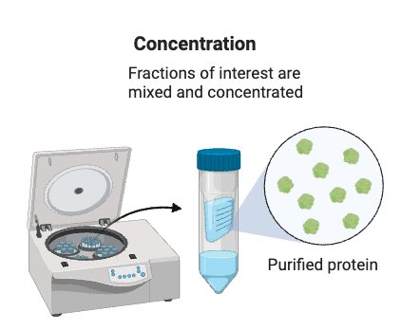
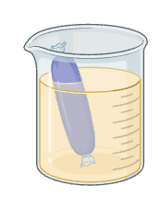
Ultrafiltration and Dialysis
Ultrafiltration
Uses semipermeable membranes and applied pressure to concentrate proteins and remove small contaminants and salts.
Dialysis
Uses a selectively permeable membrane to remove small molecules like salts, enabling buffer exchange and desalting.
Key Uses for Both Techniques
Buffer exchange, desalting, and protein concentration for downstream applications or storage.
BioRender
Notes:
Tip: Choose ultrafiltration for faster processing and dialysis for precise control in buffer exchange and contaminant removal.
Buffer based on TBS, PBS , or HEPES
2. Buffers for Stabilizing Proteins
• Glycine buffer:
• Composition: 10–100 mM glycine, pH 8.0–10.0.
Reducing agents:
• Examples: DTT to enhance stability

Slide 20
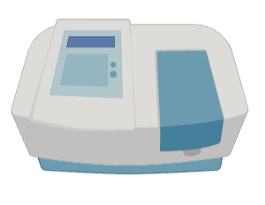
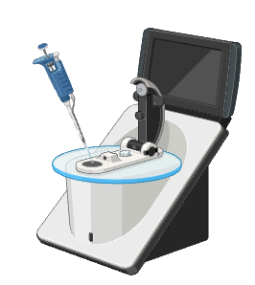
Protein Analysis
Why analyze Proteins?
Ensures concentration, purity, activity, structure, stability, and interactions meet experimental requirements
Vital for quality control in protein purification workflows
Bradford Assay:
Uses Coomassie dye to bind proteins, with color intensity proportional to concentration.
Pros: Quick, simple, low-cost.
Cons: Sensitive to detergents and sample interferences.
Nanodrop Spectrophotometer
Measures protein concentration via UV absorbance at 280 nm
Pros: Fast, minimal sample, no dyes needed
Cons: Accuracy depends on extinction coefficient 280/260 ratio: Detects nucleic acid impurities
BioRender
Notes:
• Protein analysis is a crucial step after purification to confirm that the final product meets experimental or therapeutic standards.
• Techniques are selected based on the parameter being evaluated, such as concentration or purity.
1. Bradford Assay
Principle:
Uses Coomassie Brilliant Blue dye, which binds to proteins and causes a shift in absorption
The intensity of the color change is proportional to protein concentration
Advantages:
Quick, simple, and low-cost
Limitations:
Sensitivity to detergents or other interfering substances in the sample
2. Nanodrop Spectrophotometer
Principle:
Measures protein concentration by UV absorbance at 280 nm (based on aromatic amino acids)
Advantages:
Fast and requires minimal sample volume
Does not rely on additional reagents or dyes
280/260 lower ratio indicates nucleic acid impurities
Limitations:
Accuracy depends on the protein’s extinction coefficient

Slide 21
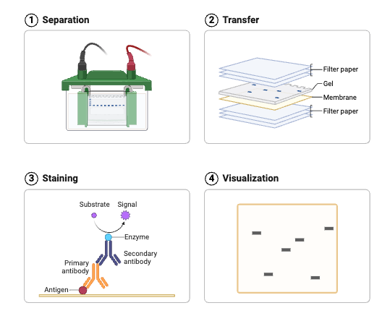
Purity Analysis
SDS-PAGE
Proteins are denatured and separated by size in a polyacrylamide gel
Advantages:
Provides a clear visualization of protein purity
Estimates molecular weight
Limitations:
Requires staining and careful sample preparation
Western Blotting
After SDS-PAGE, proteins are transferred to a membrane and detected using specific antibodies
Advantages:
Confirms the presence of the target protein
Can validate the purity of a specific protein
Limitations:
Time-intensive and requires access to specific antibodies
BioRender
Notes:
• SDS-PAGE is the go-to method for assessing protein size and purity. Staining the gel reveals all protein bands, allowing you to detect contaminants.
• Western blotting adds an extra layer of specificity by confirming the presence of your target protein using antibodies. While powerful, it is more time-consuming and antibody-dependent.
Key Takeaway: Each method serves a specific purpose and can be combined for a comprehensive analysis of protein quality.

Slide 22
Thank you for your attention!

